Slide 1
Exploratory data Analysis using Python
Dataset - Business Sales

Slide 2
Project Goal
Deep analysis on Business Dataset to
Check how the data is spread around mean
Identify if there are outliers
Treating the missing values across the features
Distribution and multi-collinearity among the features
Aggregating/grouping the data to find trends across them, and raw analysis with out any feature encoding
Use the advanced python techniques like lamda and user defined functions. Pivot tables etc
Finally detail out the insights learnt from the overall analysis

Slide 3
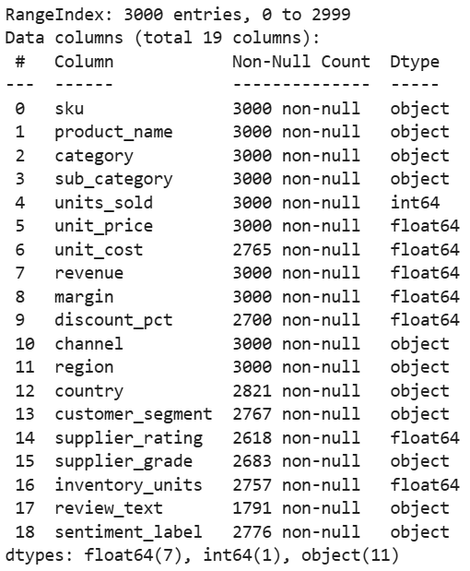
Dataset Explanation
Source : Kaggle.com
Dataset containing 19 features and 3000 records, features:
Meaning of each field
Product_name - Name of the product
category - Each product is identified in different category like peripherals
sub_category - Categories are further divided in sub categories
units_sold - Sale volume
unit_price - Unit price of each product
unit_cost - Cost of production
revenue - Earnings from the product sales
margin - Margin in each of the sales
discount_pct - Discount percentage
channel - Sale channel
Region - Sales Region
Country - Sales country
Customer segment - Customers are divided based on their segments
supplier_rating - Ratings given by the customers
supplier_grade - Supplier grade
inventory_units - Product units in stock
review_text - Review comments given by the customers
sentiment_level - Customer's sentiment level
Numerical features
units_sold
unit_price
unit_cost
revenue
Margin
discount_pct
supplier_rating
inventory_units
Categorical features
Sku
product_name
category
sub_category
channel
Region
country
customer_segment
supplier_grade
review_text
sentiment_label
Missing values in 8 features like unit_cost, unit_cost, country etc

Slide 4
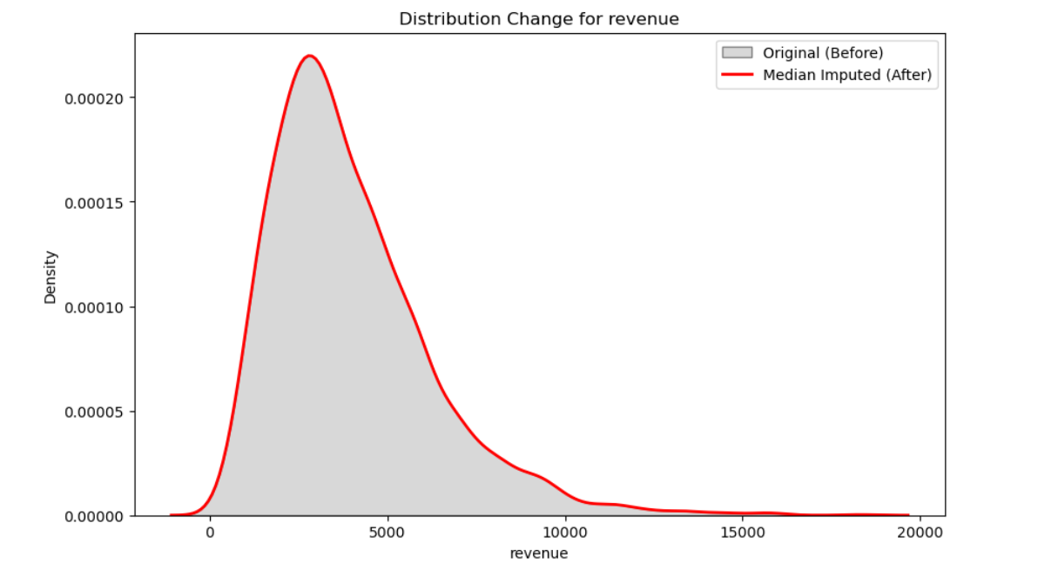
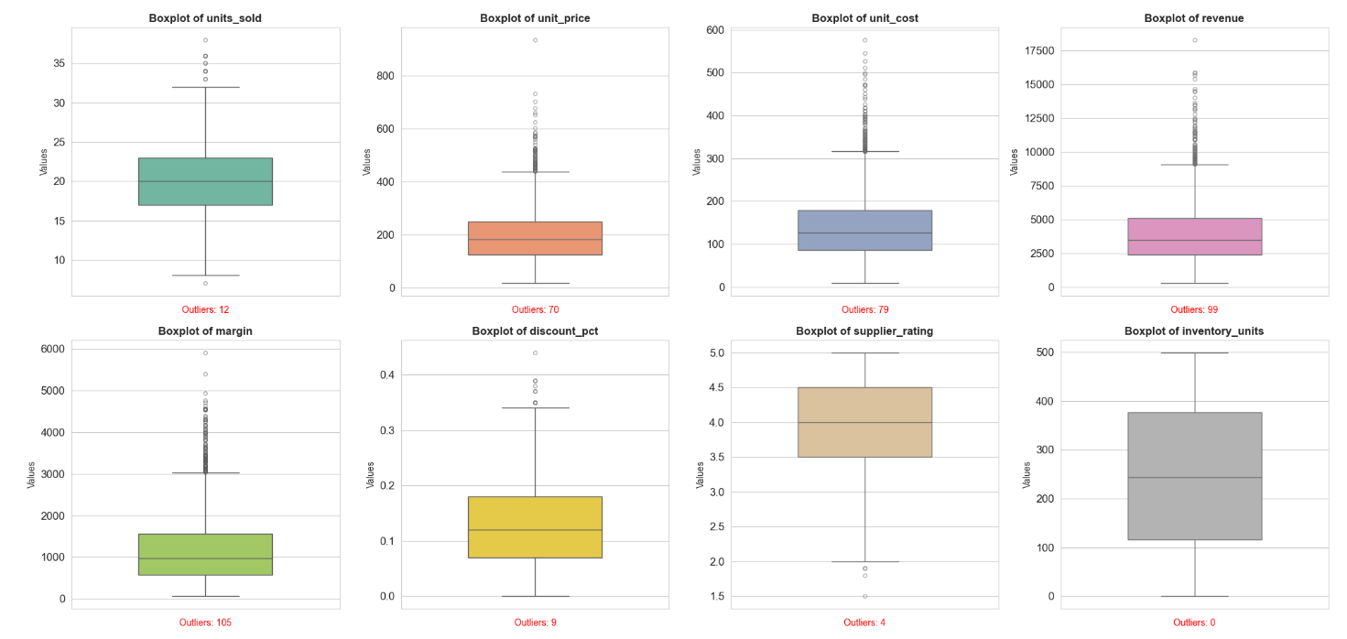
Data cleaning
Handling Missing Values : Since outliers are present in most of the columns, we’ll go with median for imputation
Unit_cost is an exception where we’ll use category-wise mean
Replacing missing values with Median
Eg: Plotted a graph for Revenue
which is been replaced by median

Slide 5
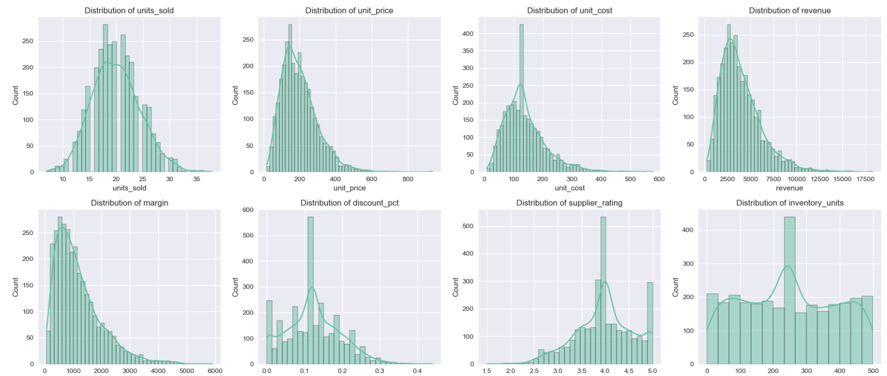
Insights about the Numerical Data
Unit sold has nearly uniform distribution
Unit price is a right skewed
Unit cost is a right skewed
Revenue is strongly right‑skewed, indicating that while most SKUs generate revenue in the lower ranges, a small proportion of high‑priced or high‑volume items contribute disproportionately to total sales.
Margin is strongly right‑skewed, indicating that while most SKUs has lower margin, only a small proportion of the products has higher margins
Discount percent is a multi model feature
Supplier rating is left skewed and multi model featureInventory units is equially distributed feature

Slide 6
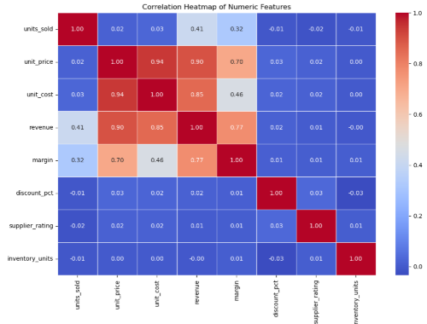
Corelation Heatmap
Top 3 features that are strongly correlated (Considering from 0.7 to 1)
Unit price →unit cost = 0.94(Strong)
Unit price → revenue = 0.9
unit cost → revenue = 0.85
margin → revenue = 0.77
Unit price → margin = 0.7 (Low)

Slide 7
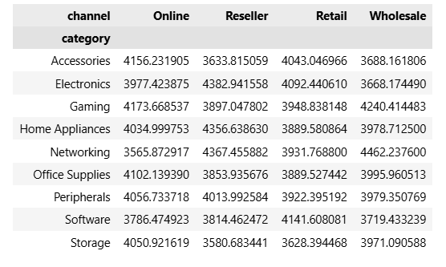
Analysis for Categorical Data
Pivot tables help us in analyzing categorical data
Comparing average revenue with combinations of category and channel.
Comparing average margin with region and customer_segment.

Slide 8
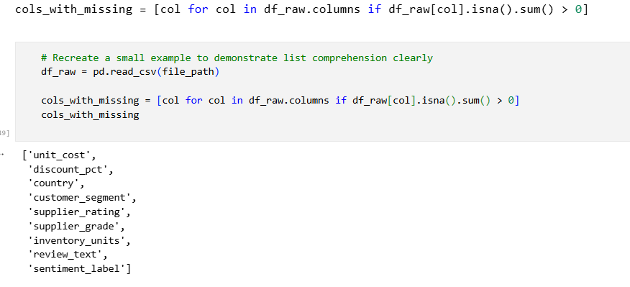
List Comprehension
Used to generate list of columns that has missing values

Slide 9
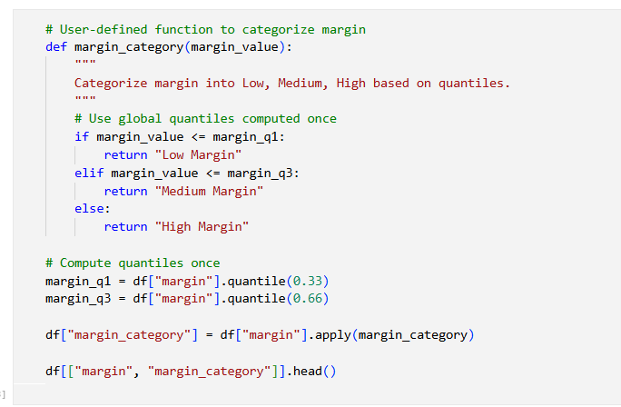
Lamda Function – User defined
This function is used to classify categorical data as Low Margin, Medium Margin and High Margin

Slide 10
Insights after Analysis
The dataset: Around 3,000 product transactions spread across 19 columns — SKUs, pricing, margins, channels, regions, customer sentiment, the works. We cleaned things up by imputing missing values (median for the skewed numerical stuff, category-wise mean for unit_cost so we don't mess up margin calculations, and a "Missing" placeholder for categoricals). The review_text column was 40% empty and not useful for numerical EDA anyway, so we dropped it. Zero duplicates — nice.
Correlations: Unit price, unit cost, and margin are the real drivers of revenue — strong positive correlations across the board. What's interesting is that discount percentage barely moves the needle on revenue. So just slapping discounts on everything? Probably not the best play.
Categories & Regions: Revenue is far from evenly distributed. Some categories and regions clearly dominate, and the Category × Sub-Category heatmap made it easy to spot exactly which product niches are the money-makers. That's basically the cheat sheet for where to double down on inventory and marketing.
Country-Level Profitability: Australia came out on top for total margin, with India, Brazil, and Japan not far behind. Germany and Canada are at the bottom — could be heavier discounting, lower pricing, or higher production costs. Would need to dig deeper to figure out exactly why.

Slide 11
Insights after Analysis
Suppliers: Pretty balanced across grades A, B, and C — Grade B is slightly more common, but no single grade dominates. Supplier ratings cluster tightly around 4.0, and they don't really correlate with financial performance. Good suppliers don't automatically mean better sales, apparently.
Profitability Classification: We built a simple classifier using quantile-based revenue and margin bands, and it split products into five buckets. Stable Performers are the biggest group — they keep the lights on. High Profit Performers are the ones to invest in. Revenue Drivers with Low Margin could use some cost optimization. Premium Niche Performers have untapped potential if we can get them more visibility. And Poor Performers? Time to rethink or phase them out.
Sentiment: The crosstab showed that sentiment is spread pretty evenly across categories — so it's not like one product type is getting all the bad reviews. Customer sentiment seems to be more about the individual experience (pricing, delivery, quality) than about what category they bought from.
Things we'd explore with more time / data:
Time-series trends — if we had date columns, we could spot seasonality and growth patterns
NLP on the review text we dropped — there might be gold in those customer comments
Finding the sweet spot for discounts — is there a level that actually drives conversions without killing margins?
Why Germany and Canada lag on margins — a proper country-level deep dive
A real customer segmentation model instead of just the labels we have

